Slide 1
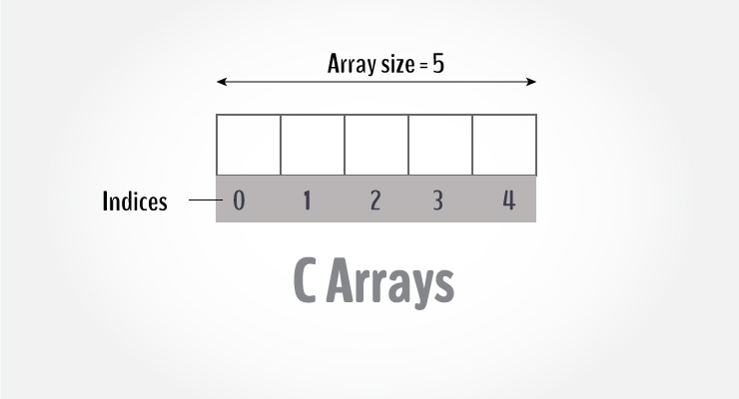
Arrays in ‘c’ language

Slide 2
Introduction
An array is a collection of data that holds fixed number of values of same type.
It is also known as a set.
An array is a data type.
Representation of a large number of homogeneous values.
Structures of related data items.
Static entity – same size throughout program.
Group of consecutive memory locations.
Array size must be a constant value.

Slide 3
How to declare an array in C?
To refer to an element, specify
Array name
Position number / index/ subscript
Format:
data_type array_name[array_size];
For example: if you want to store marks of 100 students, you can create an array for it. → int marks[100];
We have declared an array with name “marks” of int type and size 100, that means, it can hold 100 int values.
The size and type of arrays cannot be changed after its declaration.

Slide 4
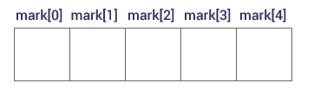
Elements of an array and how to access them?
By default, first element is always at position 0.
You can access elements of an array by indices.
Suppose you declared an array mark as float mark[5]. The first element is mark[0], second element is mark[1] and so on.
Arrays have 0 as the first index not 1. In this example, mark[0].
If the size of an array is n, to access the last element, (n-1) index is used. In this example, mark[4].
Suppose the starting address of mark[0] is 2120. Then, the next address, a[1], will be 2124, address of a[2] will be 2128 and so on. It's because the size of a float is 4 bytes.
Hence, address of any element will be
add of mark[i] = add of mark[0] + i * sizeof(datatype)

Slide 5
Types of arrays
There are 2 types of C arrays. They are:
One dimensional array
Multi dimensional array
Two dimensional array
Three dimensional array
four dimensional array etc…

Slide 6
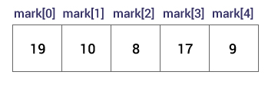
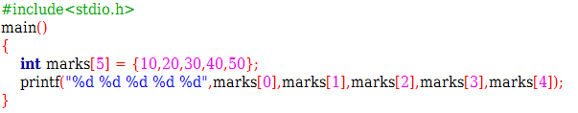
One-dimensional array
How to initialize an array in C programming?
Compile time initialization
Run time initialization
Compile time initialization
It's possible to initialize an array during declaration. For example,
int mark[5] = {19, 10, 8, 17, 9};
Another method to initialize array during declaration:
int mark[] = {19, 10, 8, 17, 9};

Slide 7
One-dimensional array
Declaring multiple arrays of same type, format similar to regular variables.
Example:
int b[ 100 ], x[ 27 ];
int n[ 5 ] = { 1, 2, 3, 4 };
If not enough initializers, rightmost elements become 0. Here, n[4] will be initialized to zero.
int n[ 5 ] = { 0 }
All elements 0
It is a best practice to initialize an array to zero or null while declaring, if we don’t assign any values to array.
C arrays have no bounds checking.
If size omitted, initializers determine it.
int n[ ] = { 1, 2, 3, 4, 5 };
5 initializers, therefore 5 element array.
If you try to access array elements outside of its bound, let's say a[12], the compiler may not show any error. However, this may cause unexpected output (undefined behavior)/garbage value.

Slide 8
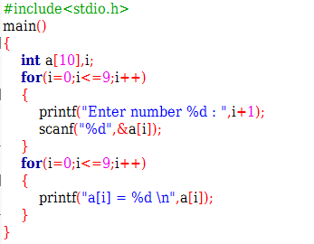
One-dimensional array
Run time initialization
It's possible to initialize an array during run time by scanning the array.

Slide 9
Basic Operations
Traverse an array- visiting and displaying each element of an array
Search an Element in an array- find the index value of an element
Update an element in an array- modify the value of an existing element
Insertion
Deletion

Slide 10
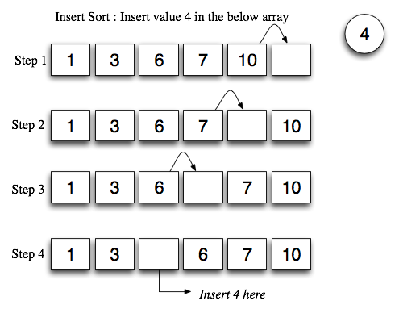
Insertion

Slide 11
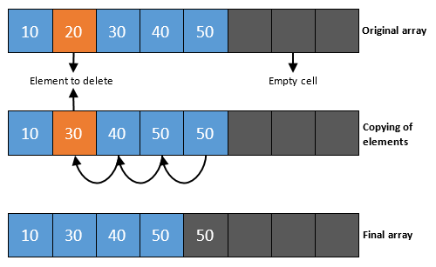
Deletion

Slide 12
Applications of 1D Array
Calculate sum and average of an array
Largest element from an array
Find odd and even number of elements from an array
Reverse an array
Searching
Sorting

Slide 13
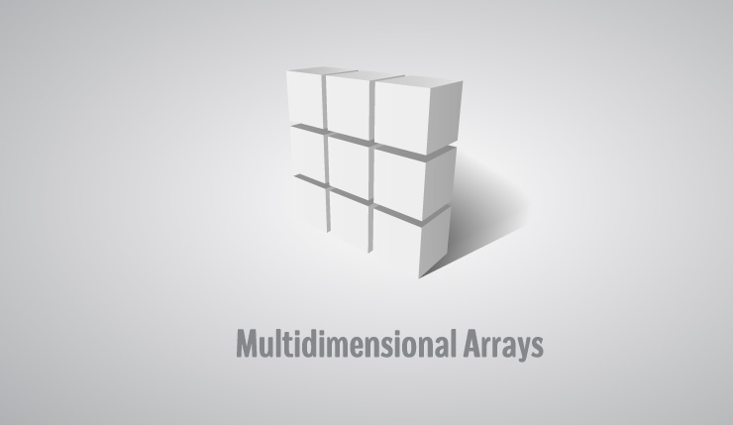
Multi-dimensional array

Slide 14
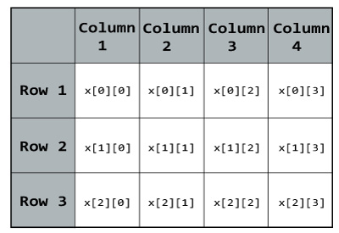
Two-dimensional array
In C programming, you can create array of an array known as multidimensional array.
For example,
float x[3][4];
Here, x is a two-dimensional (2d) array. The array can hold 12 elements. You can think the array as table with 3 row and each row has 4 column.

Slide 15
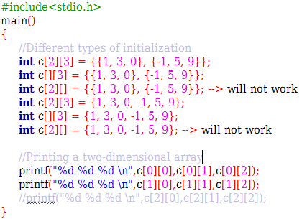
How to initialize a two-dimensional array?
There are many ways to initialize a two dimensional array (Compile Time):
int c[2][3] = {{1, 3, 0}, {-1, 5, 9}};
int c[][3] = {{1, 3, 0}, {-1, 5, 9}};
int c[2][3] = {1, 3, 0, -1, 5, 9};

Slide 16
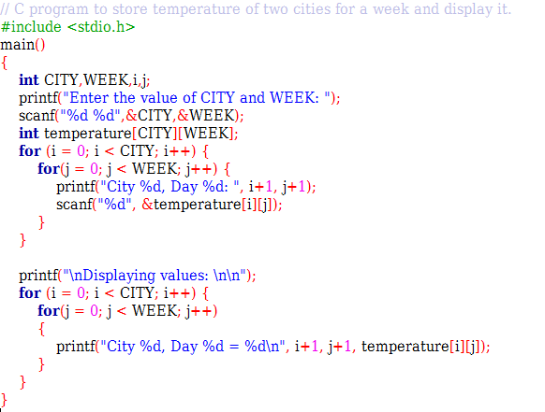
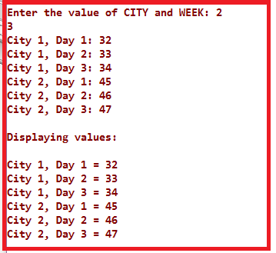
Initializing 2D array (Run time)

Slide 17
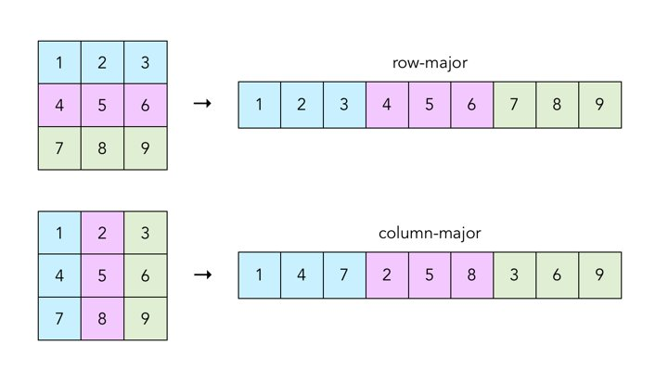
Memory representation of 2 dimensional array

Slide 18
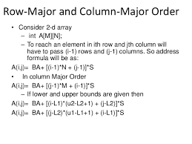
Address calculation of an element in 2 dimensional array

Slide 19
Applications of 2D Array
Multiplication Table
Matrix Operations
Addition of matrices
Multiplication of matrices
Transpose of a matrix
Symmetric matrix
etc.

Slide 20
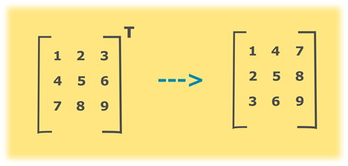
Transpose of a matrix
Transpose of a matrix can be found by interchanging rows with the column that is, rows of the original matrix will become columns of the new matrix.

Slide 21
Algorithm for finding the transpose of a matrix
Declare and initialize a 2-D array p[a][b] of order axb.
Read the matrix p[a][b] from the user.
Declare another 2-dimensional array t to store the transpose of the matrix. This array will have the reversed dimensions as of the original matrix.
The next step is to loop through the original array and convert its rows to the columns of matrix t.
Declare 2 variables i and j.
Set both i,j=0
Repeat until i<b
Repeat until j<a
t[i][j] = p[j][i]
j=j+1
i=i+1
The last step is to display the elements of the transposed matrix t.

Slide 22
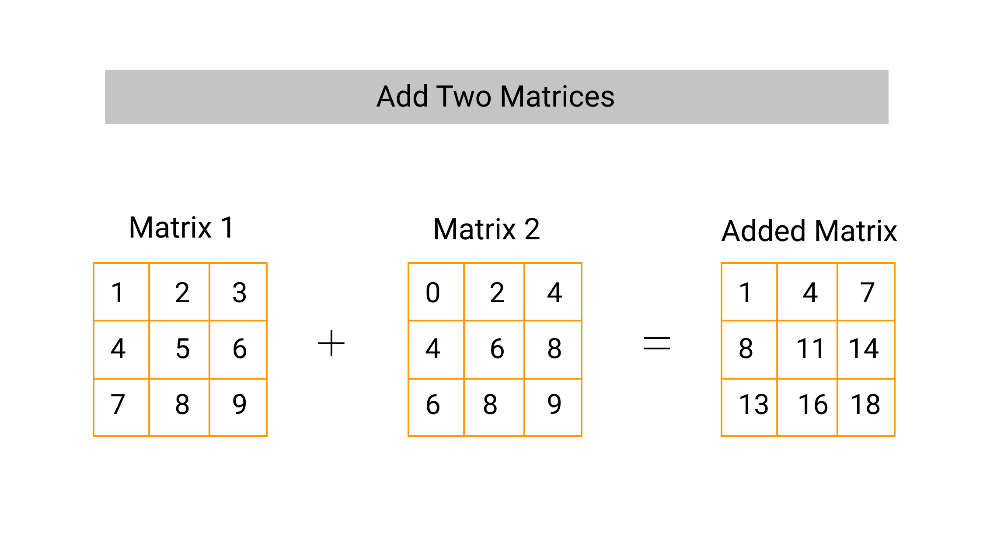
Addition of two matrices

Slide 23
Algorithm for finding the sum of two matrices.
Input matrix 1 and matrix 2.
If the number of rows and number of columns of matrix 1 and matrix 2 is equal,
for i=1 to rows[matrix 1]
for j=1 to columns [matrix 1]
Input matrix 1 [i,j]
Input matrix 2 [i,j]
matrix 3 [i,j]= matrix 1 [i,j]+ matrix 2 [i,j];
Display matrix 3 [i,j];

Slide 24
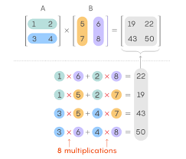
Multiplication of two matrices
Consider two matrices as A and B of dimensions m*n and n*p then the resultant product matrix AB is of dimension m*p.

Slide 25
Algorithm for matrix multiplication
Start
Declare variables and initialize necessary variables
Enter the element of matrices by row wise using loops
Check the number of rows and column of first and second matrices
If number of rows of first matrix is equal to the number of columns of second matrix, go to step 6. Otherwise, print matrix multiplication is not possible and go to step 3.
Multiply the matrices using nested loops.
Print the product in matrix form as console output.
Stop

Slide 26
Thank you
ANY QUESTIONS???

